Slide 1

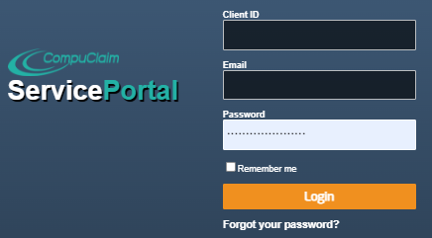
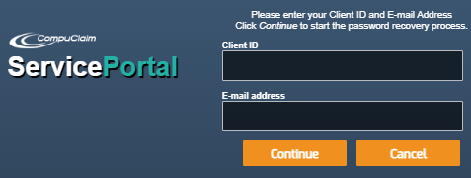
Provider User Guide for the Service Portal
To login:
https://serviceportal.compuclaim.com
Client ID: MD
Enter your email address
Enter your assigned password
Click on login
Forgot your password?
Click here if you forgot your password
Enter your Client ID: MD
Enter the email address we have on file for you
Select continue
You will receive confirmation that a “new random password has been created and sent to your e-mail”.
Updated 7/14/2023

Slide 2
Navigating the Site
The top right corner of the Service Portal displays the Navigational Links that are available continuously throughout the system.
My account: To change password
Log out: Ends session
Home: Returns you to home page.
Wizards: This is how you will log eligible services.
  Service Log by Student Wizard –Where services are entered for students on your caseload. Users may select one student, multiple or all students. You must choose at least one student.
  Edit Student Service Logs – You can edit all service logs as long as status is pending. You can change service documentation, add or delete comments or change time. You can also delete services if needed.
  Supervision Log – Use this wizard if you need to complete supervision logs. Supervisors have been assigned to supervise providers and are required to view and approve students’ service logs before they can be submitted for reimbursement.
Reports: Live Reports can be saved or printed
  Logging Summary
  Detailed Student Report
  Monthly Student Log.
Manage Caseload: Providers can easily add/remove students to and from their caseload.
Help : Training Videos and answers to frequent questions.
Guides and Resources: Guides and Resources is an easy to use, centralized location for important SBCH program related documents that are frequently used by related services providers.

Slide 3
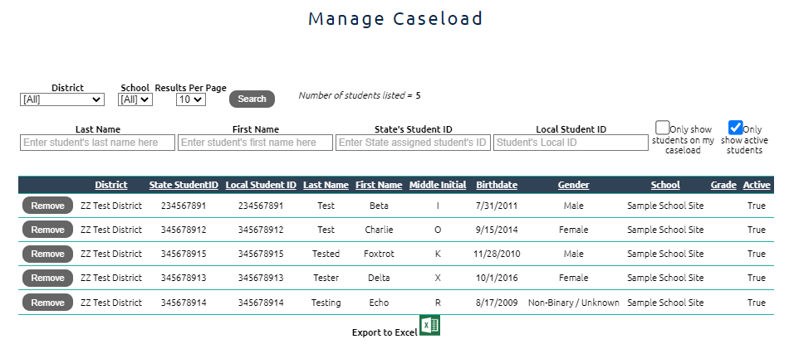
Managing Your Caseload
Click the “Manage Caseload’ link to view available students in district to add to your caseload.
Students in the portal are a district choice. You may see the entire student population or only students in Special Education.
New students or students in the identification phase may not appear immediately.
If you cannot find a student as your district administrator/ Medicaid coordinator for assistance.
Search for students by entering a few letters of the last and or first name.
To add a student, click on the “Add” button to the left.
To remove a student from your caseload, click on the “Remove” button to the left.
Use the “only show students on my caseload” box to quickly see the students you have previously selected.
You will notice the ‘Only show active students’ button is selected by default. This will allow you to only search for students currently active within the district. If you unselect this button, you will be able to find students who may have left district and are no longer active.

Slide 4
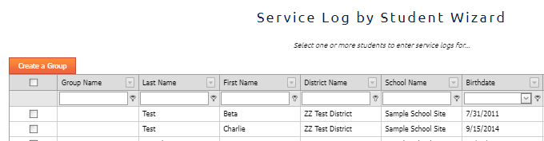
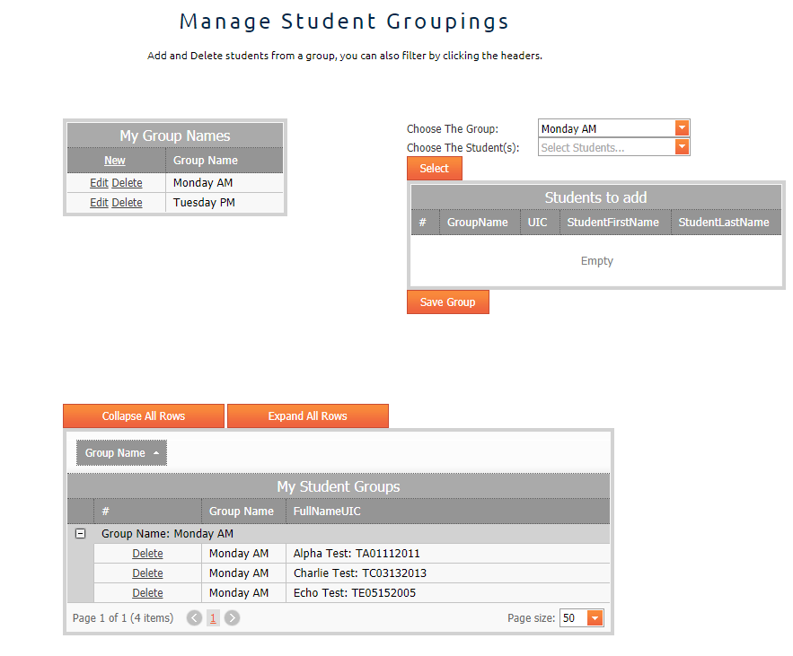
Creating Caseload Groups
You have the ability “set” permanent groups within your caseload. Use this feature when you work with the same students on a routine basis. To add a student to a group the student must be on your caseload. Access this feature through the Service Log by Student Wizard page
1
2
3

Slide 5
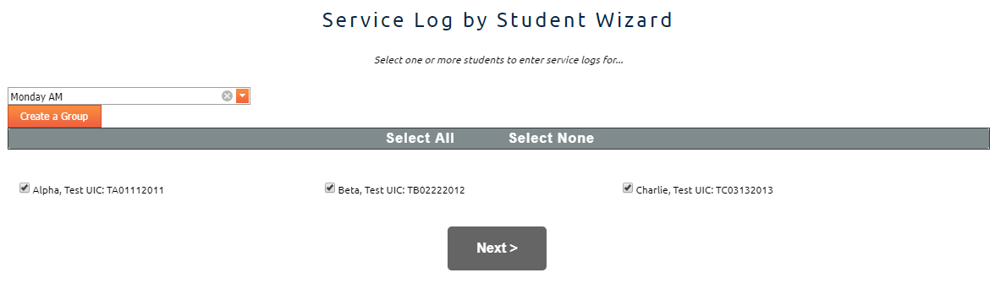
Creating Caseload Groups
Click on the “Create a Group” button on the Service Log by Student Wizard page.
Create your group names by clicking “New”. Once you have named your group click “update” below. See #1 in the diagram.
Add students to your group. See #2 in the diagram.
  Choose the group name.
  Choose your students by placing a check mark in the box to the left of the student name.
  Click “Close” in bottom right corner of the open drop down box.
  Click “Select”. Your students should appear in the small box below.
  Click “Save Group”
Review your groups. See #3 in the diagram
  Find your group name in the box “My Student Groups”. There might be multiple pages, look for the numbers and arrows below the box if needed.
  Click on the small box to the left of the group name to expand the group.
  Use the “delete” button to remove any students as needed.
To log services, select your desired group from the small drop down on the Service log by Student Wizard. Once your students display click the “next” button and move on to the calendar. Select your date or dates and proceed.

Slide 6

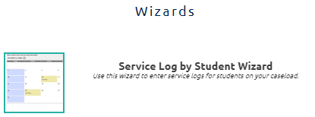
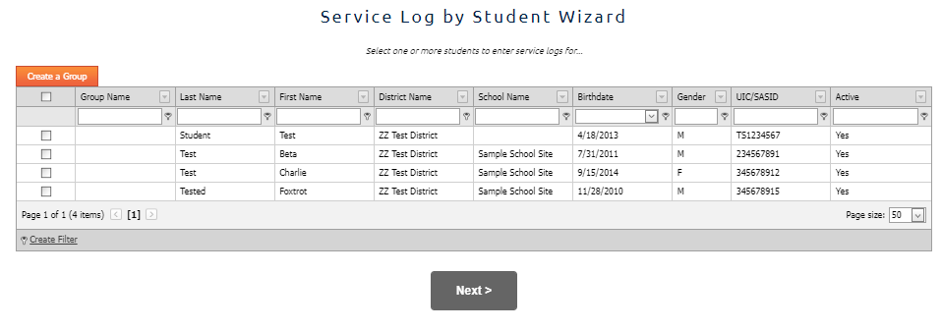

Logging Services
Click Wizards in the navigation bar
Select Service Log by Student Wizard
Select one or more students by placing a checkmark in the box for the student(s) you want to enter logs for.
Click “Next” to move on to the calendar.

Slide 7
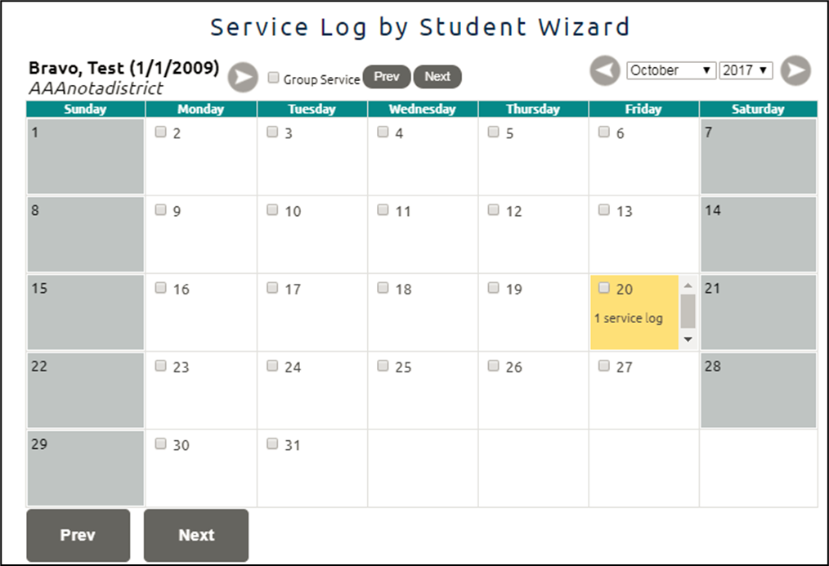

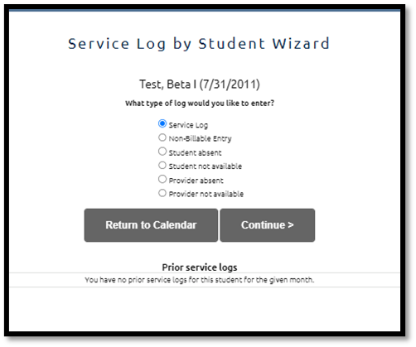
The calendar will display the current month. You may navigate to previous months using the drop down or the arrows above the calendar.
Select the day you wish to log by placing a check mark in the small box on the day you wish to document.
You may also select multiple days. Select all the days within the month you wish to document.
Weekends are not available for documentation.
If you have selected multiple students that you wish to document as a group you must place a check mark in the “Group Service” box near the student name.
You may select multiple days for multiple students.
Once you have selected the day or days you wish to document click “Next”.
If you have only chosen one student / one day you will be given the option of what to enter.
Indicate the log you wish to document. Select “Service Log” for direct service. You may use the additional options to document non-billable services if desired.

Slide 8
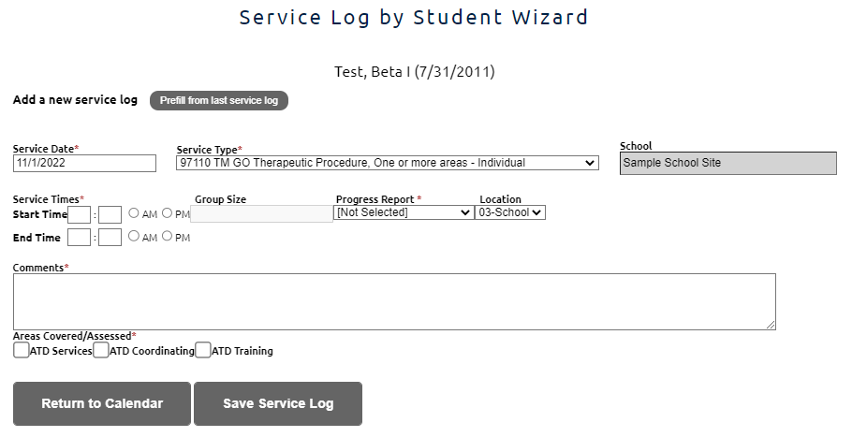

Service Log Page
Confirm the student.
Confirm the date. You may change if needed by clicking on the Service Date field.
From the Service Type dropdown, select the service you provided.
The page will change as you select different services. Complete the required fields.
Enter the start time.
Enter the end time.
Select an option from the Progress Report drop down if required.
Enter Comments: Comments should include a description of the event, observations and outcomes from the session. Comments are typically a SOAP note in nature.
Select the Areas Covered/Assessed. You must select one but may select all that apply.
Select ‘Save Service Log’
NOTE: The Service Portal is an electronic logging tool. How you use it is up to you and the district you work for. You may use it as a record keeping location in addition to a Medicaid billing tool. However, Medicaid is only concerned with the billable pieces and required documentation to support those services. Entering student absences is not required by Medicaid.

Slide 9

Suggestions for Logging- Do what works for you
Below are options on how you can enter information into the Service Portal. Start each process by clicking on Wizards in the navigation bar. Select “Service Log by Student Wizard” to proceed.
One Student- One day
You may want to log just one student at a time. As you create logs on this student the “prefill from last service log” button comes in handy.
By click the button all of the previous information except the comments is automatically populated. Enter a comment to complete the log.
Multiple students - one day
Select all of the students you serviced on one day. On the calendar place a check mark in the “group service” box. Select a day and click next. You will now be taken through all of the students you selected in alphabetical order. Be sure to pay close attention to the student and the service delivered. You can also use this feature if you wish to log a non-billable note such as early dismissal or delay opening.
One Student , One Month of services
Select your student. On the calendar select all of the days you provided service. Click next and begin the process. If you have selected 3 services days in the month, you will have 3 logs to complete.
As you complete your logs make sure the date and service are correct. Clicking “save service log” will move all information to the next log. You can edit any information along the way. Keep in mind as you change services you may be required to enter more information to complete a new log.
You may place more than one entry on a day. This could be multiple services, non-billable notes or monthly progress.

Slide 10
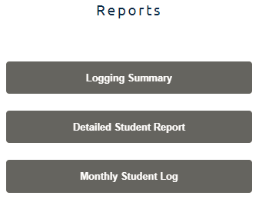
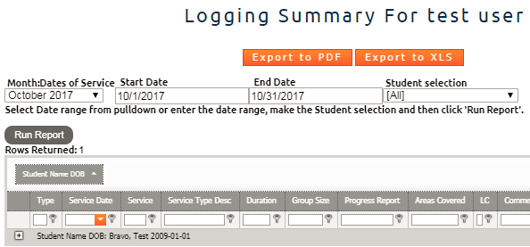
Reports
You have the ability to create reports for your personal use. These reports may be for a variety of reasons; audits, meetings, transfer of student to another provider, etc.
Logging Summary- a great way to get an excel spreadsheet of your services over a longer period of time for multiple students.
Detailed Student Report- This is a great option for when needing to discuss services with a coworker or parent.
Monthly Student Log- This is an attendance grid of the student caseload you have indicated. You can print it out and use it as you see fit.
Creating a Report
Click on Reports in the navigation bar
Select the report you wish to create
Select the date range and student
Click the Run Report
Information will display below
Export to PDF or XLS (Excel) for printing

Slide 11

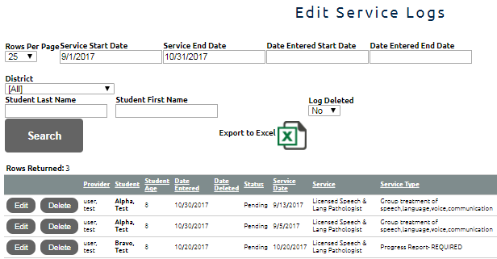
Editing and Deleting logs
You have the ability to edit and delete any logs that have not been submitted to Medicaid for billing. If a log has been submitted for billing it is visible on a report but longer editable.
Quickly delete an entry during the logging process by clicking on the visible trash can.
Editing a log
Click on Wizards
Select “Edit Student Service Logs”
Enter some information to refine your search. Student name and date of service are useful.
Click Search
Logs will display below. Select edit or delete to modify a record
If you can not find the log it is not available to you. It has been moved on for billing. If the log was an error, please contact the Medicaid Coordinator in your district.
Deleting a log
Click on Wizards
Select “Edit Student Service Logs”
Enter some information to refine your search. Student name and date of service are useful.
Click Search
Logs will display below. Click on delete.
If you can not find the log it is not available to you. It has been moved on for billing. If the log was an error, please contact the Medicaid Coordinator in your district.

Slide 12
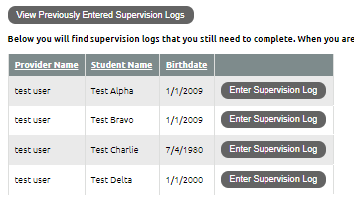

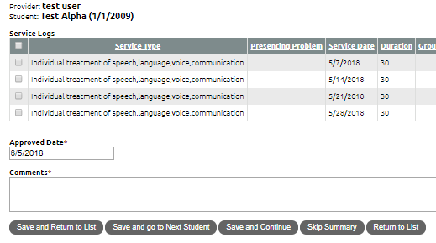
Supervision Wizard
If you are a supervising clinician (OT, PT, Speech, BCBA) and have a COTA, PTA, SLPA, or BCaBCA/Behavior Tech assigned to you, you MUST approve their logs each month in the service portal.
Login to the Service Portal
Click on Wizards
Click on Supervision Log Wizard
Click on “Enter Supervision Log”
.
Place a check mark in the box down the left hand side. Placing a checkmark in the box located in the title bar will check all the logs.

Slide 13
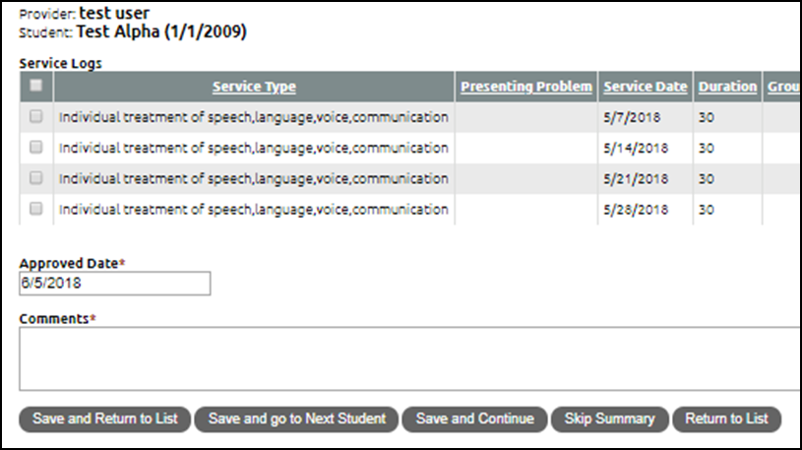
Enter a short sentence in the comments box. “I have reviewed and approved these entries.” is sufficient.
Click one of the buttons with “save” in it.
  Save and Return to List takes you back to the students with logs requiring supervision.
  Save and go to next student takes you to the next student in alphabetical order
  Save and continue will let you see the next page of logs on the current student.

Slide 14
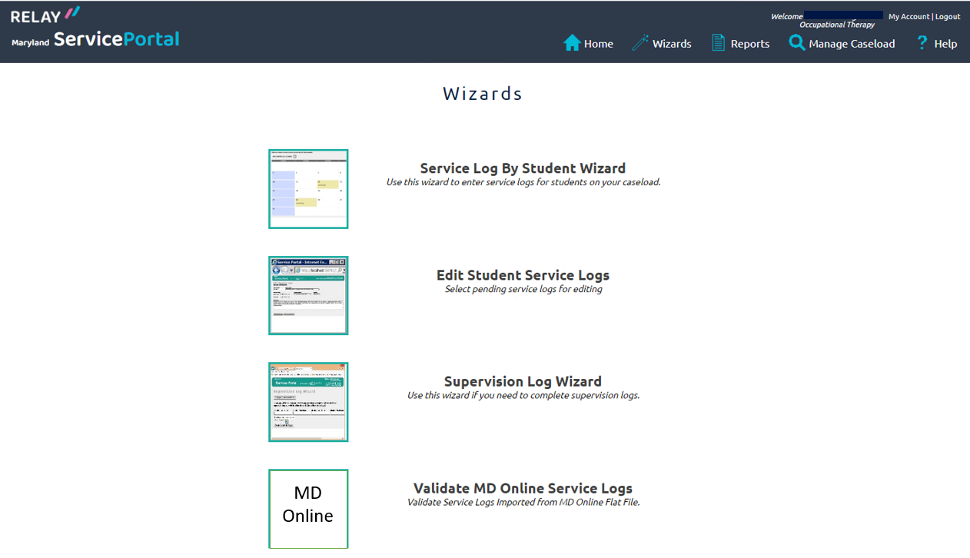
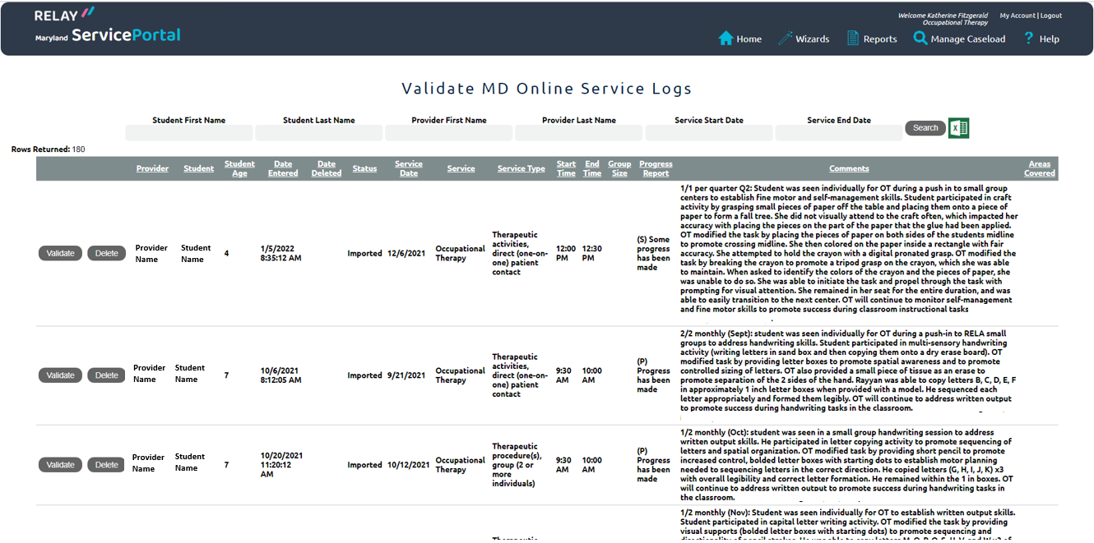
Validating MDOnline Entries
Services entered into MDOnline will be imported into the Relay system for the Medicaid billing process. Data imported from MD Online requires a provider to review and validate the service. Validating the service confirms the service delivered, confirms the service type and stamps the record with a provider’s electronic signature.
Click on Wizards
Click on Validate MD Online Service Logs
Services to be validated will be listed below. You may filter by student or date.

Slide 15
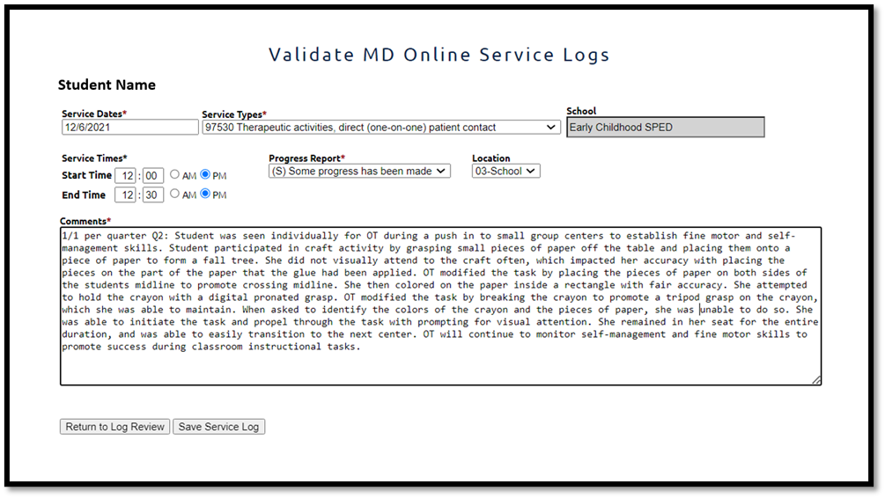

Click to open the record.
This allows the provider to alter the entry as needed. It is important that the details of the entry are reviewed and corrected if necessary. Pay attention to the service type and comments that may indicate the student was absent or the service was non-billable.
Clicking “Save Service Log” will close the record and move it forward for the next step.

